Slide 1
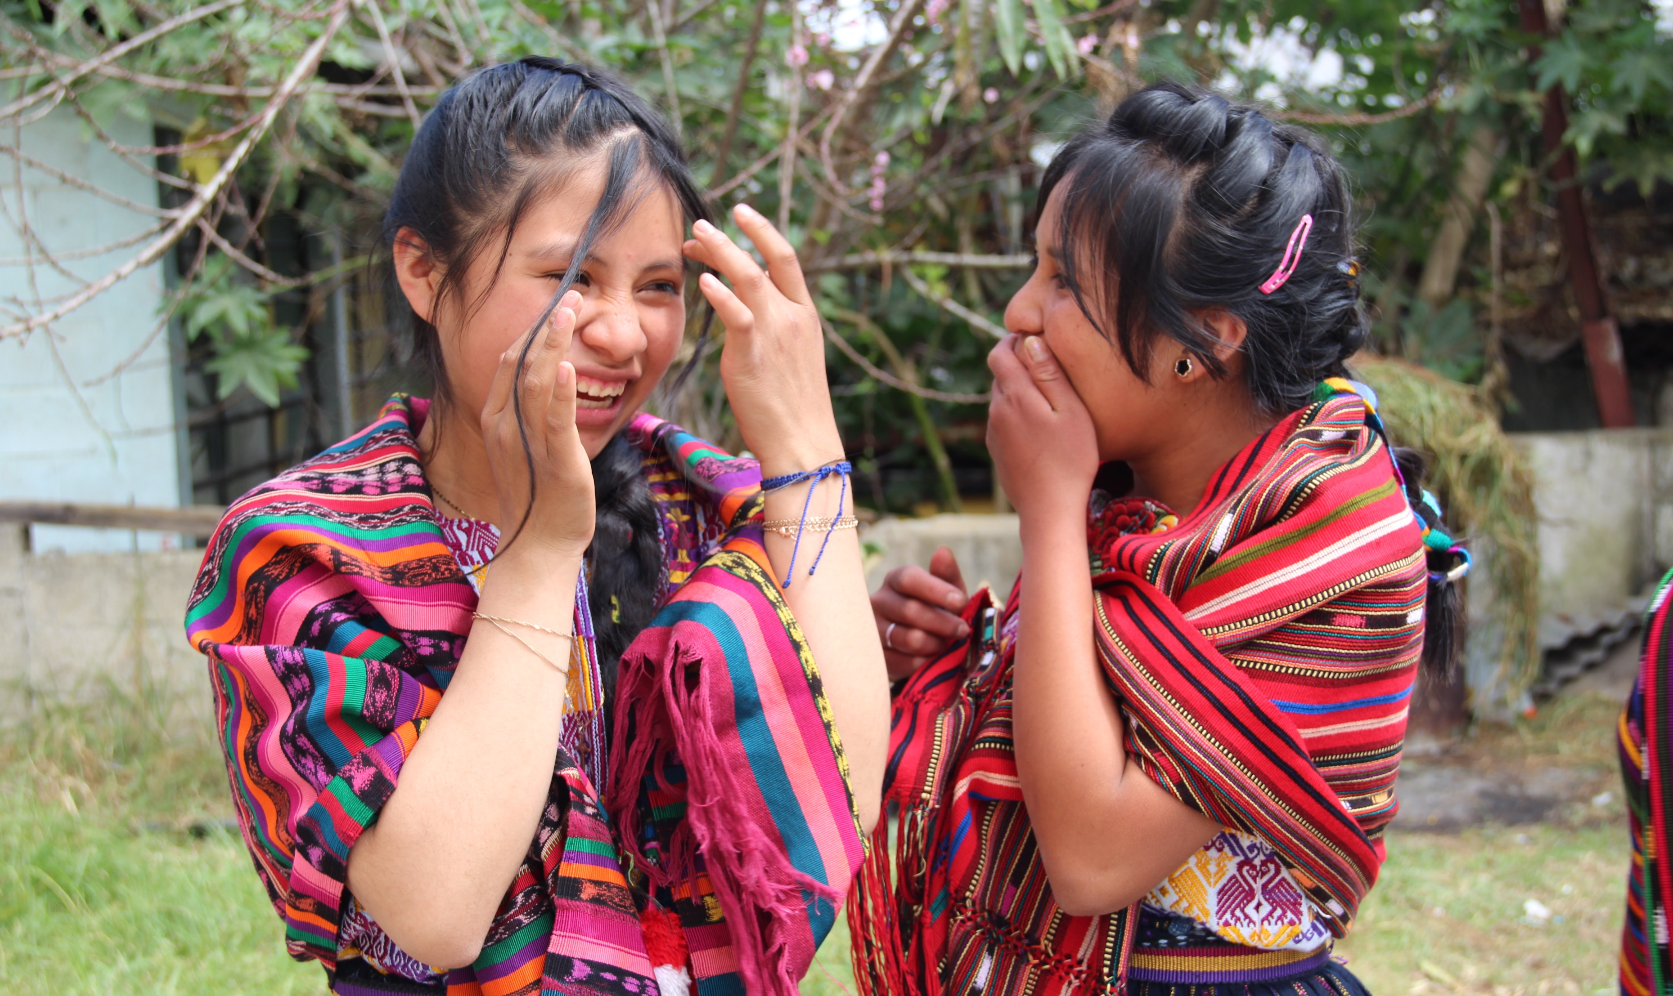
breaking the cycle of poverty in Guatemala
THROUGH EDUCATION
Notes:
Introduce yourself, any others with you, and thank hosts for inviting you to speak.
The Guatemala Literacy Project’s (the GLP’s) mission is to improve education for underserved students in Guatemala, with the ultimate goal of breaking the cycle of poverty for them and their families entirely.
More optional info:
The Guatemala Literacy Project (GLP) is one of the largest grassroots, multi-club, multi-district projects in Rotary. More than 800 clubs and 90 districts have been working together since 1997 to improve education for underserved students in Guatemala. In that time, more than 295,000 students have been served through four sustainable programs that are tested and proven to work.

Slide 2
Notes:
Some background on Guatemala…
Central American Country
Population: ~18 million
Ethnic Makeup: 56% Mestizo (mixed Amerindian-Spanish - in local Spanish called Ladino)
41.7% Maya, 1.8% Xinca (Indigenous, non-Maya), 0.2% African descent, 0.1% Garifuna (mixed West and Central African, Island Carib, and Arawak) 0.1%

Slide 3
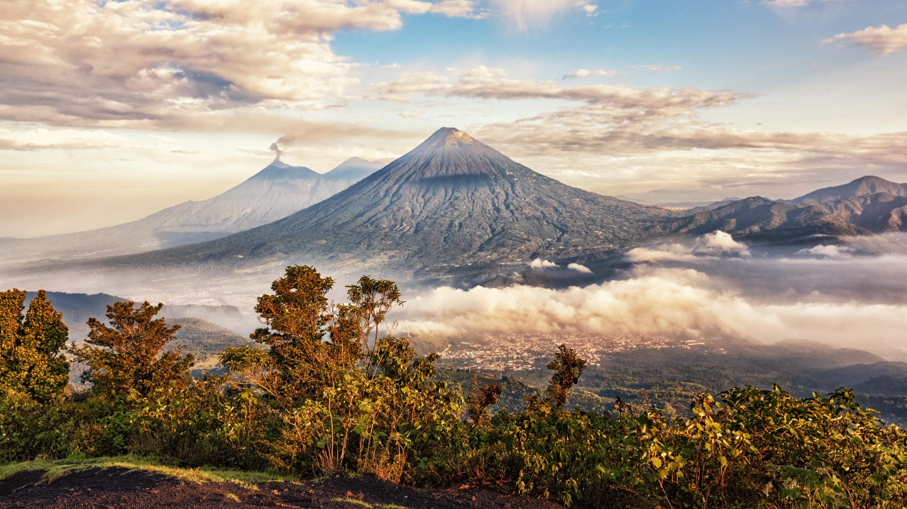
Notes:
Guatemala is a beautiful country with sweeping landscapes and lush jungles.
It’s nutrient rich soil for farming (when not in drought season) comes from active volcanoes. Country exports items like coffee, chocolate, bananas, textiles, sugar, spices, and even metal & petroleum.
However, the indigenous population seems to benefit the least from their resourceful country.
Resources:
Guatemala mainly exports coffee and clothes, each representing 12 percent of total exports. Other exports include: sugar, banana and precious metals. Guatemala's mains export partner is the United States (40 percent of exports).

Slide 4
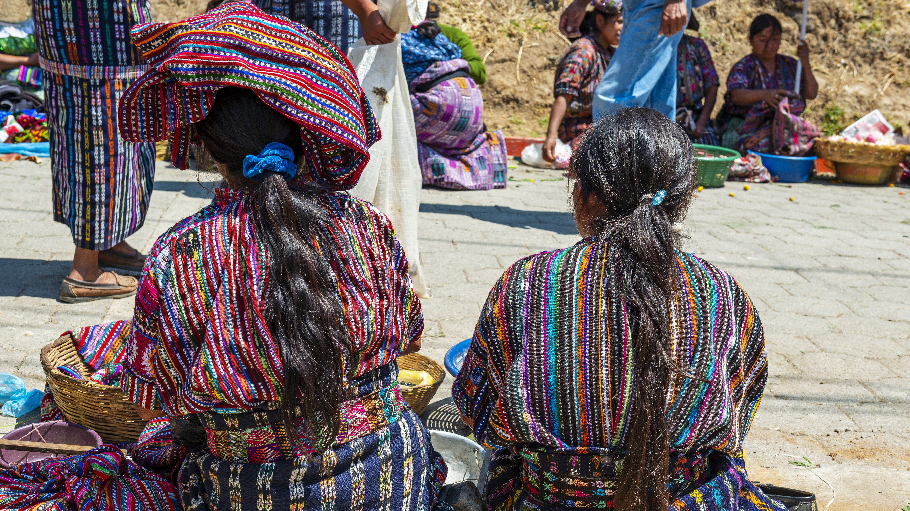
Notes:
This is a factor that contributes to 40% of indigenous Guatemalans being stuck in a cycle of poverty.
Here are two indigenous women working as street vendors selling their beautiful handmade cultural textiles.
Optional: Share the intricacies of indigenous textiles and how colors and patterns can even indicate what village or community an individual is from!

Slide 5
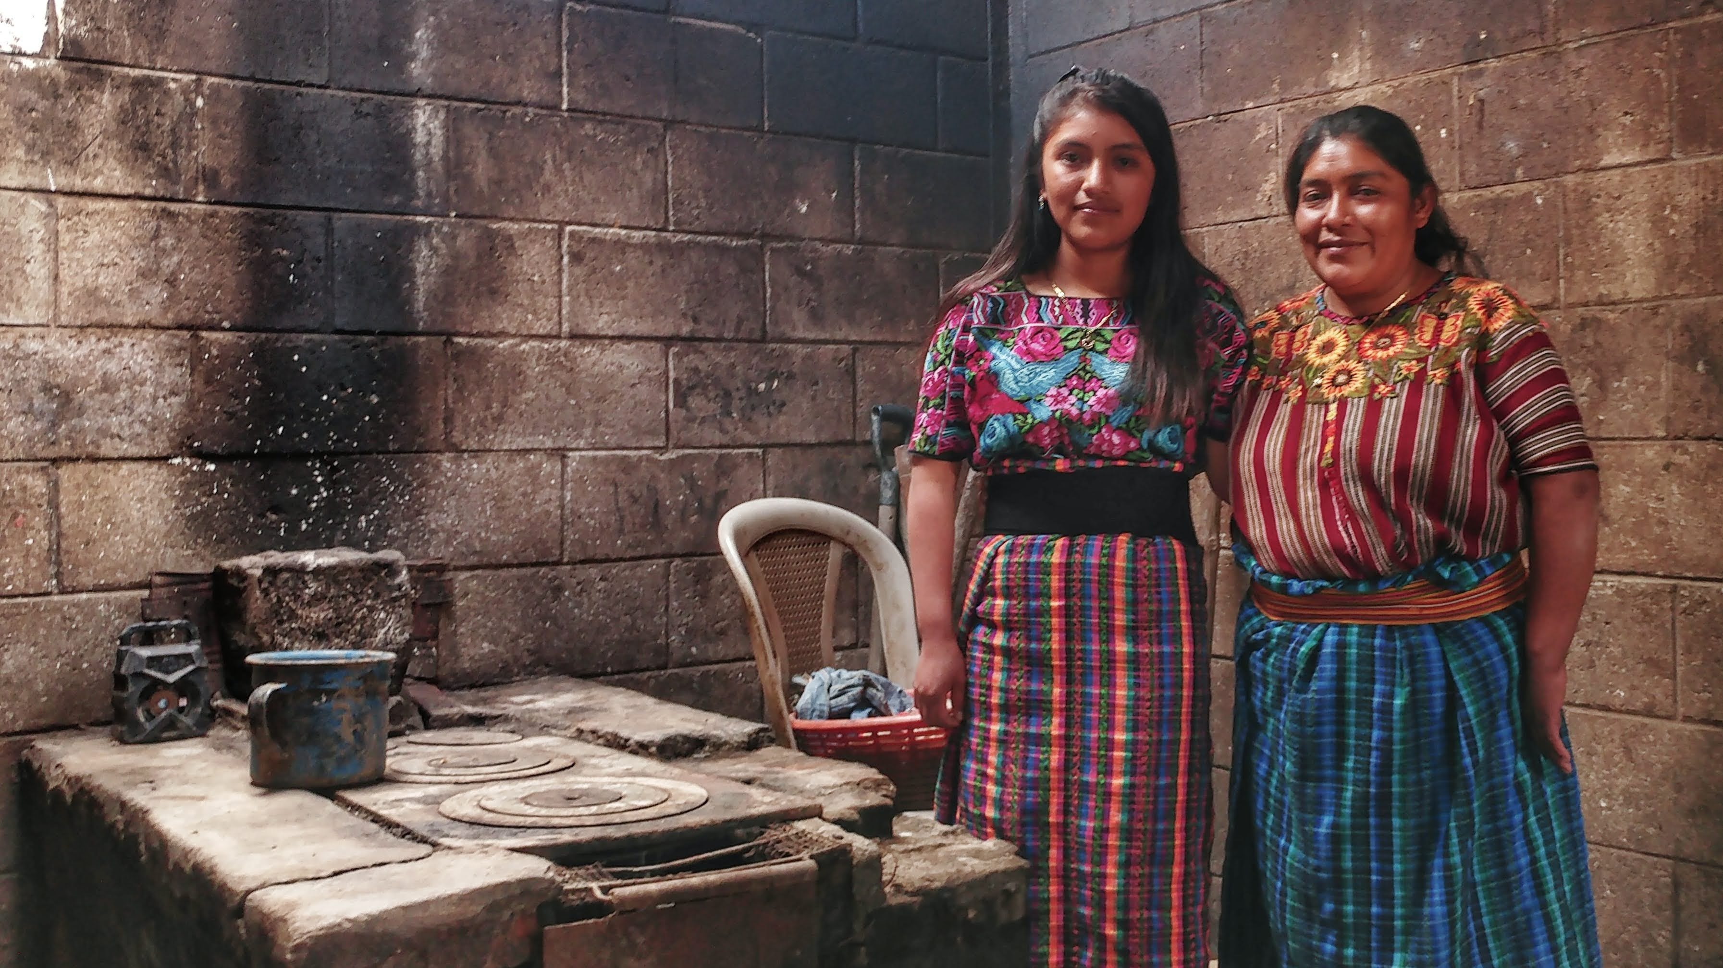
Notes:
80% live in poverty; 1/3 can’t read or write.
Nearly 2 out of 3 children are pulled out of school by the 7th grade because their parents can’t afford to continue their education.
Note: Rural Guatemala used to be the least educated in western hemisphere, now second to Haiti. Both destinations in great need with many NGOs Rotary projects present in country to help.

Slide 6
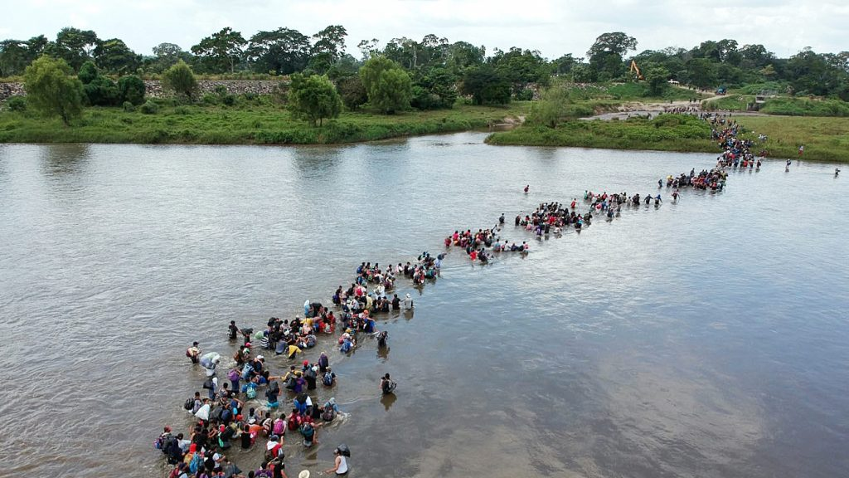
Notes:
These conditions, including violence from gang and drug activity, fuel high rates of migration northward.
Families and even unaccompanied children from Guatemala continue to flee to other countries, like Mexico and the U.S… in search of safety and more opportunities in life.
Guatemala is now the largest source country for undocumented migration to the United States. (It recently passed Mexico, which is 10X larger in population.)

Slide 7
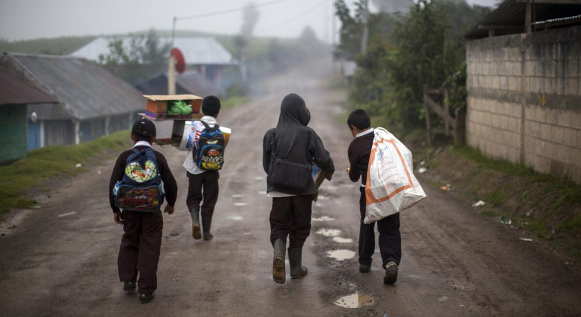
Notes:
No one should have to migrate to survive.
I think most people can agree on the benefits of creating opportunities for people in their home countries, so that they have options for their families, instead of feeling forced to migrate.
That should be a choice, not the only option. And we at CoEd aim to give families options through our mission.
Does anyone know our mission? “Breaking the cycle of poverty in Guatemala through education.”
And this is how we aim to do that…

Slide 8
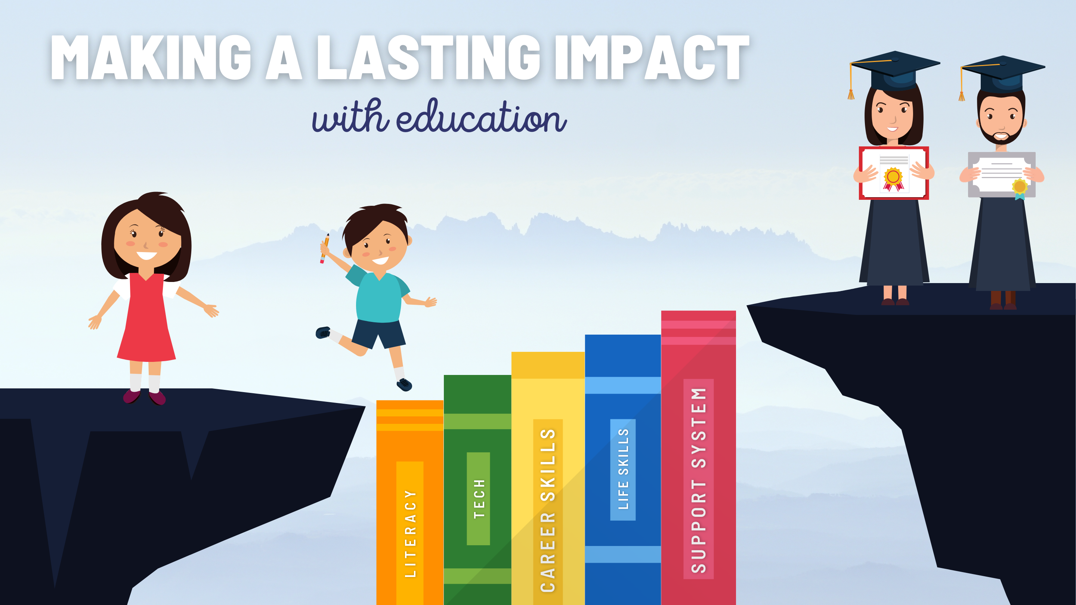
Notes:
So how can we break this cycle of poverty in Guatemala?
Education.
Our 4 programs (Reading, Textbooks, Computers, and Scholarships) are making a lasting impact on students and teachers in rural Guatemala by “bridging the gap” [click next for book animation] to make it to high school graduation!

Slide 9
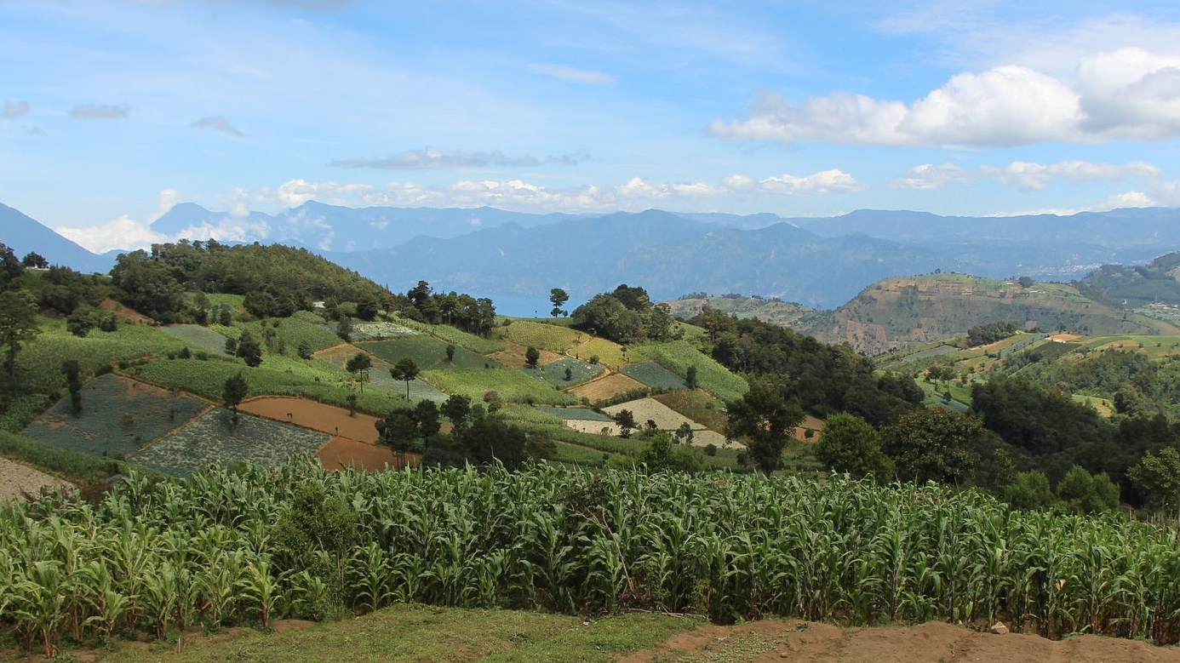
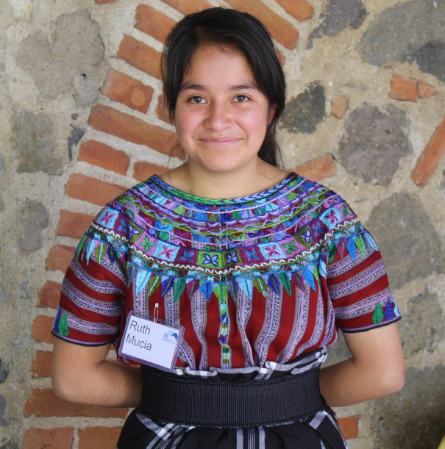
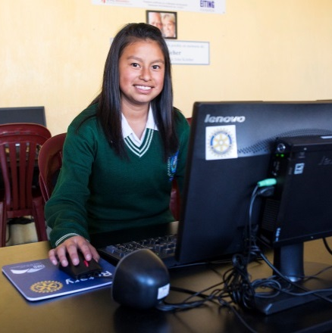
Textbooks
Rise
Computers
7th – 12th grade
Spark
7th – 9th grade
A comprehensive approach
K – 6th grade
Notes:
Cooperative for Education has a comprehensive approach to education.
When a student starts in primary school they learn to read with our Spark Reading Program
Then they move onto middle school where they are further equipped with textbooks and have the chance to learn skills in technology through our computer program
Finally that student can become a Rise scholar and will graduate high school with a scholarship and receive invaluable youth development training

Slide 10
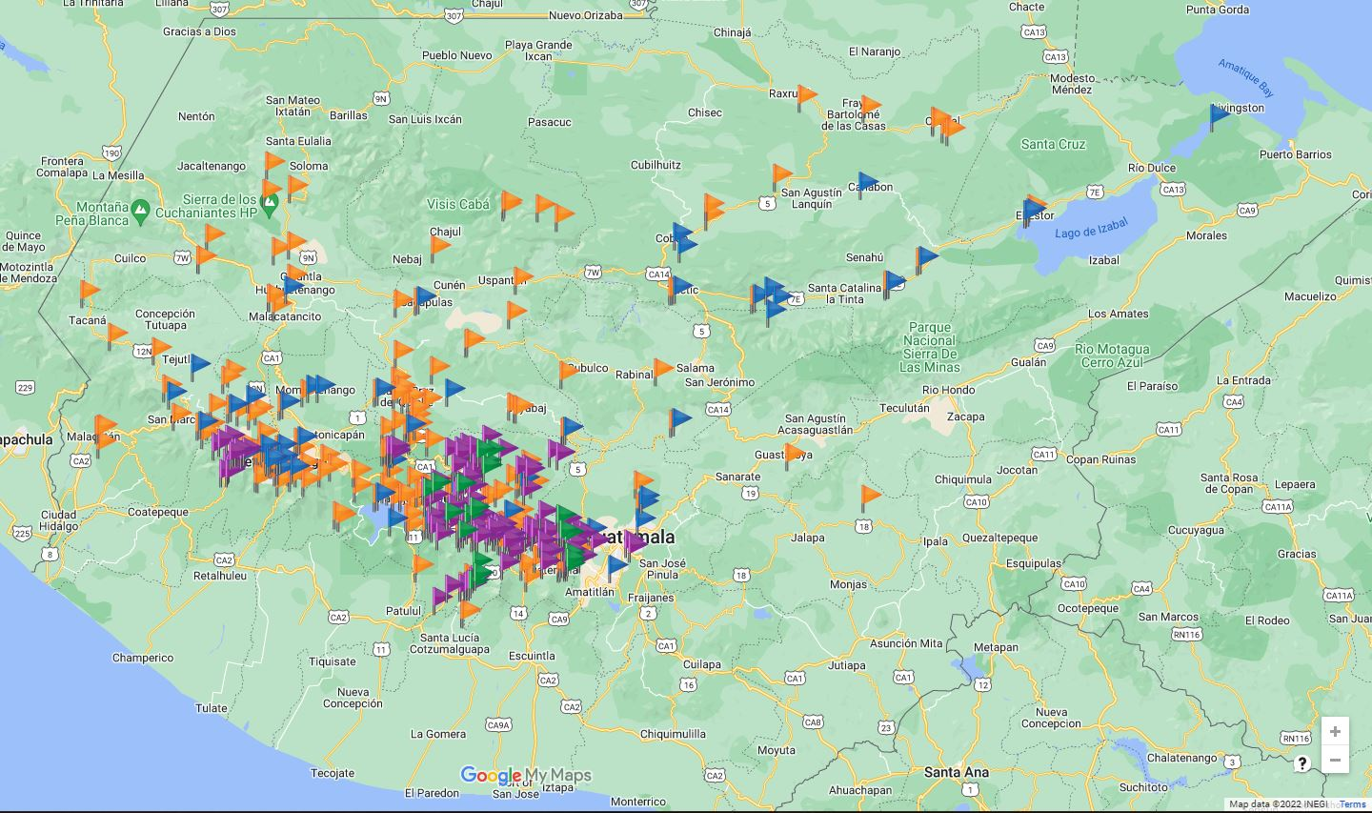
2024 ACTIVE PROGRAMS
180 Textbook Projects
152 Reading Programs
57 Computer Centers
1,056 Rise Scholars
Over 295,000 students benefitted
Notes:
Over 260,000 students benefitted– that’s the McDonald’s number - enough to fill your average baseball stadium 5 times over!
- 191 Textbook Projects
136 Spark Reading Programs – Teaching kids to read better, faster, and earlier.
56 Computer Centers, educating 14,000 kids every day.
930 students on scholarship
We are changing Guatemala… and through Guatemala…changing… the world. And we want you to join us.

Slide 11
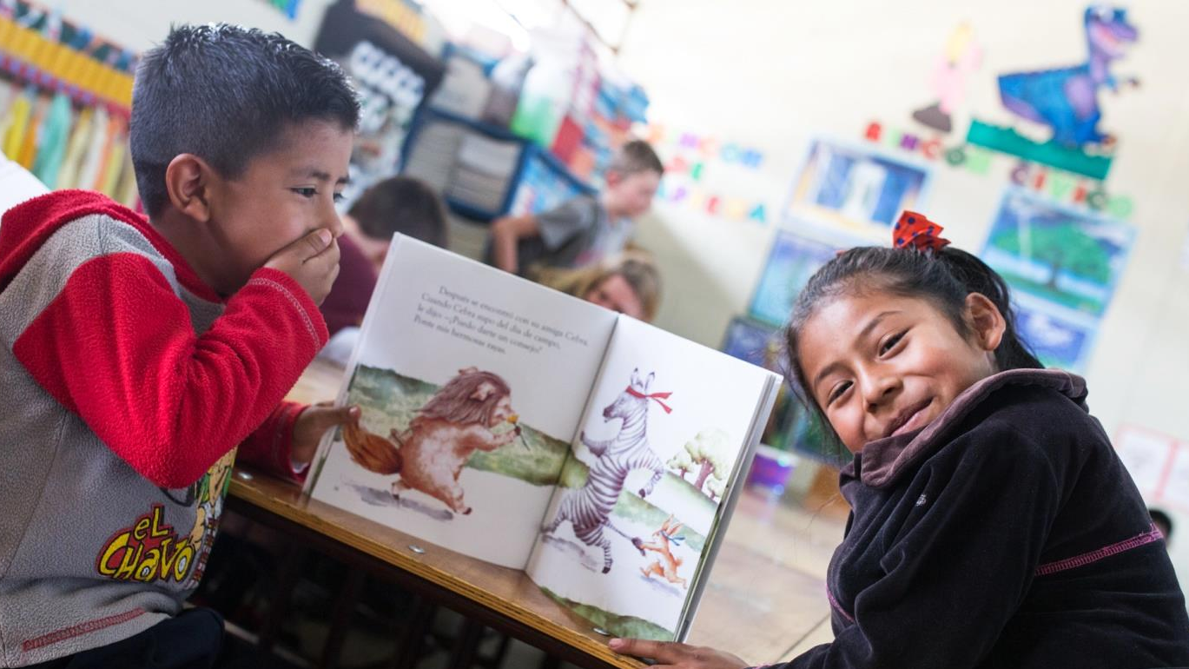
Spark Reading Program
Notes:
Spark Reading Program: 1 in 3 indigenous Guatemalans cannot read or write.
The GLP currently has 152 Spark Reading Programs active at partner schools across rural Guatemala.
In these programs, Spark teachers receive 42 hours of training, 3-5 in-class observations from a licensed trainer, and an average of 150 books for their classroom. They learn over 100 different techniques to engage their students in the reading process

Slide 12
Book Deliveries
Notes:
CoEd’s Spark Reading Program continues to provide teachers with books and study guides to rotate between their students’ homes during the pandemic. Thanks to training videos and a virtual platform, they are also able to continue studying best practices for reading education, even while in-person training is suspended due to COVID-19. Chimaltenango, November 2020.

Slide 13
Spark Reading Corners
Notes:
Spark Reading Corners
First-grade teacher Blanca Mactzul said that ”In a very creative way, kids progressed at home. My students can now read and write. I am convinced that the future of this country depends on each child who puts in the effort to learn to read and write, hope lies on them, and I am sure there is a bright future ahead.

Slide 14
Notes:
Principal and staff member at Chajalajya show off the take-home study guides or tarjetones they received through the Spark Reading Program for their students to use at home.Ma y 2021.

Slide 15
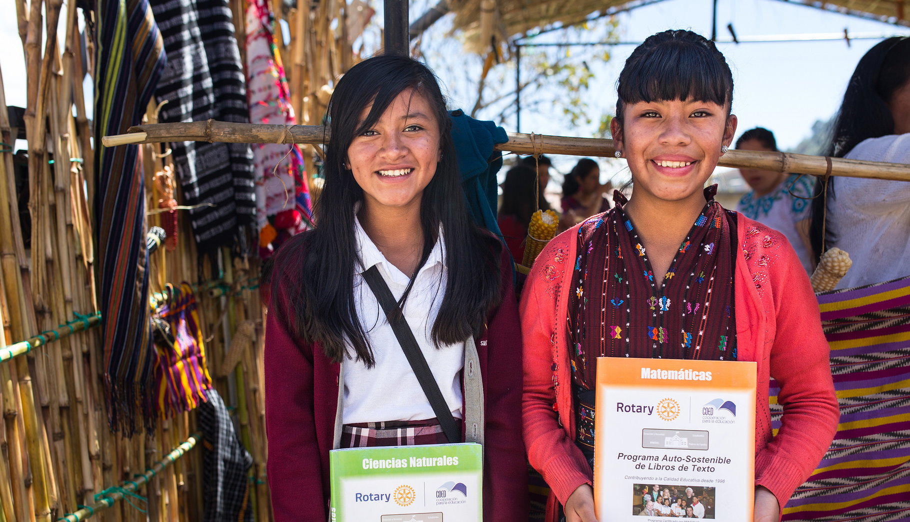
Textbooks
Notes:
Textbooks: 90% of rural Guatemalan classrooms don’t have textbooks. Can you imagine going through school without any textbooks?
If you give a teacher textbooks, you give them a quarter of their class time back. Just think how much more students learn in a year! Because of this, kids who receive textbooks score significantly higher on national standardized tests (in math and reading) than kids who don’t.

Slide 16
Textbook Teacher Trainings
Notes:
During a training session, a Textbook Program teacher uses her smartphone to learn to use a virtual platform that provides a host of educational resources, improving her teaching methods and allowing her to be the best she can be for her students during this difficult time. February 2021.

Slide 17
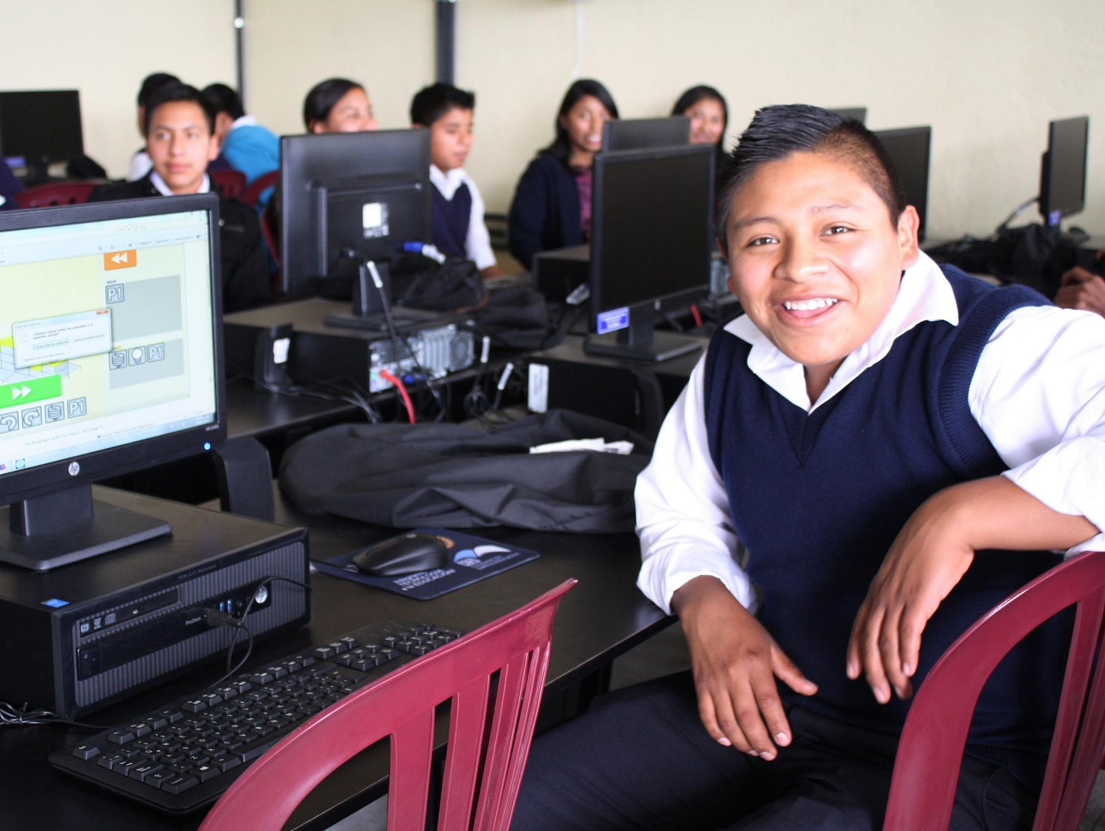
Computers
Notes:
Computers: Rural Guatemalan students lack opportunities to gain tech skills.
We provide computers to these schools and students receive training on how to use them. Over their 3 years of middle school they receive 100 lessons on using a computer. At the end of those 3 years, 95% of students find jobs with their new skills or continue their education in high school—an astounding number.

Slide 18
Notes:
CoEd Computer Supervisors like Leonel (pictured here with a Computer Center student in Almolonga before the pandemic hit) have leveraged their expert knowledge to convert the program’s training contents into a virtual format. Quetza ltena ngo, Feb. 2020.

Slide 19
Computer Training Seminars
Notes:
Teachers from CoEd Computer Centers kicked off the 2021 school year with some in-person training seminars, before another wave of COVID suspended in-person activities. By September, all of their labs had been installed with the virtual platform that will enable them to provide consistent education for their students even during these constantly-changing circumstances.

Slide 20
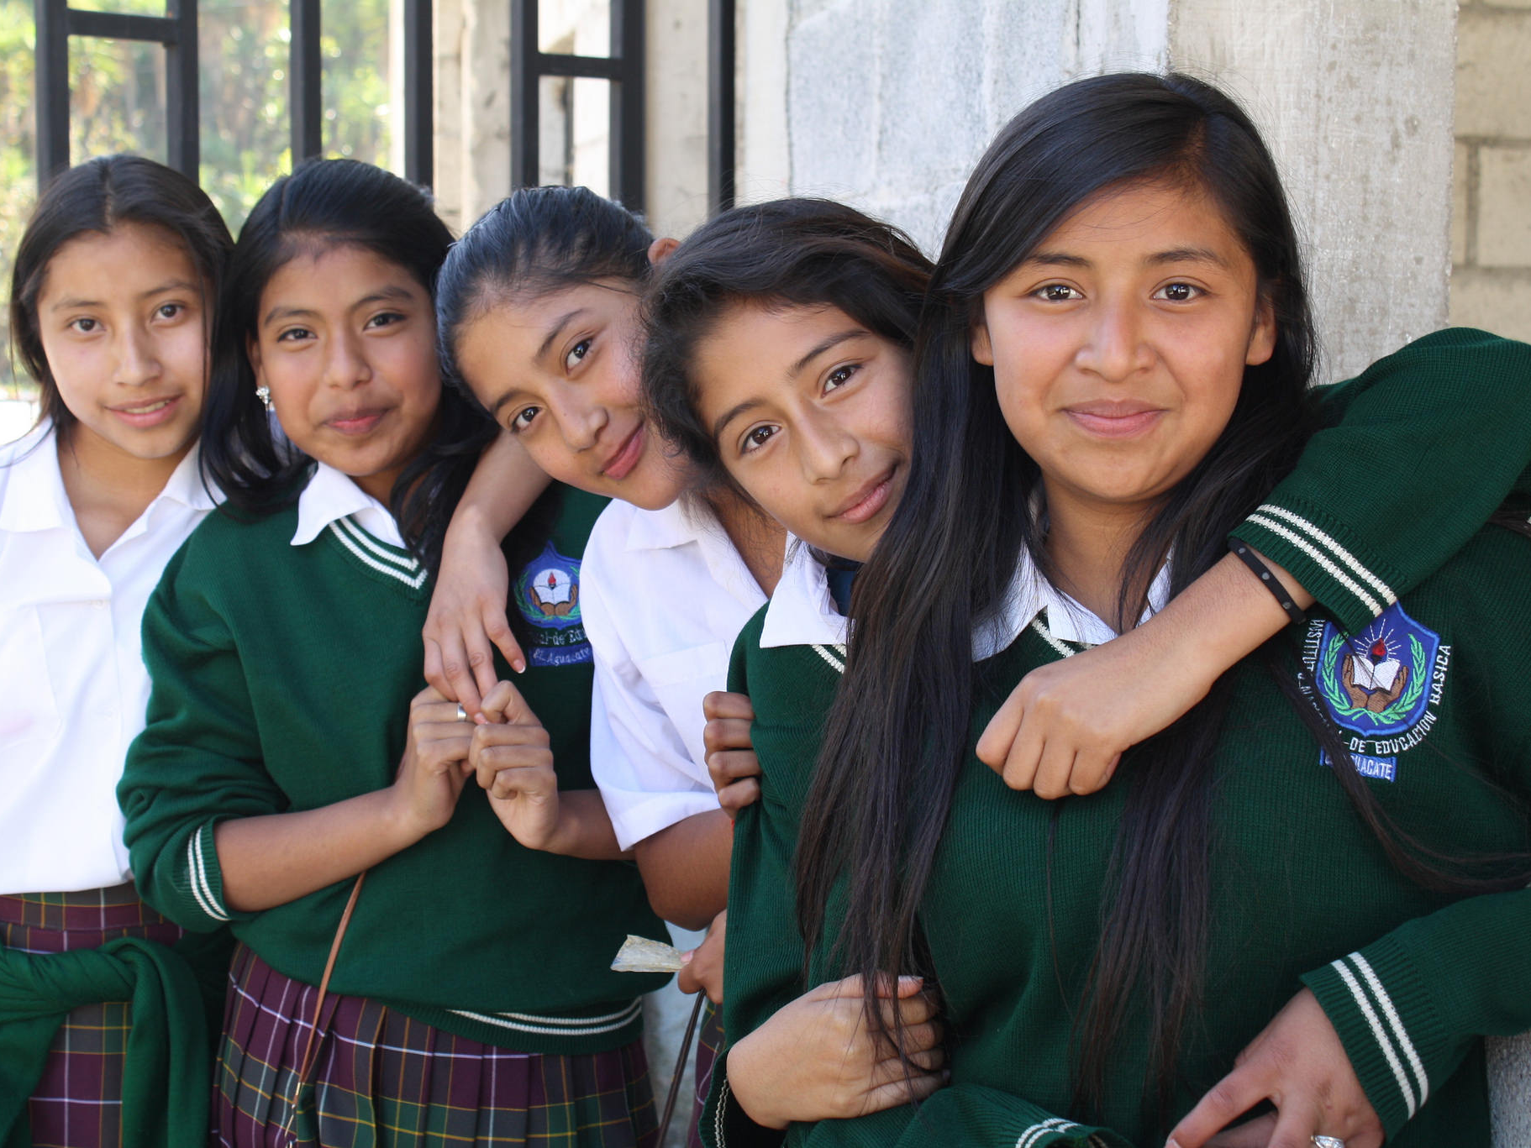
Rise
Youth Development Program
Notes:
Rise Youth Development Program: Approx. 10% of impoverished Guatemalans graduate from high school.
The Rise Program selects students who are about to drop out of school and skyrockets their graduation rate to 90%, offering not just a scholarship, but wrap-around support.

Slide 21
Notes:
With our overall goal remaining to help Guatemalan students, specifically rural, indigenous students, get to high school graduation. Once they achieve this milestone, doors open that were once closed.
We truly believe that these children, once educated, will help pull their communities, their regions, and ultimately Guatemala… permanently out of poverty.

Slide 22
Mental Health Services
Notes:
Our Rise Youth Development Team also saw a great need for mental health support for our scholarship students due to rising struggles for their families due to the continued effects of the pandemic.
This includes students who have lost relatives to illness, immigration, or have fallen into even more extreme poverty to lack of reliable work opportunities, and many more difficult factors.
Any students in our Rise program who need access to counseling now have it.

Slide 23
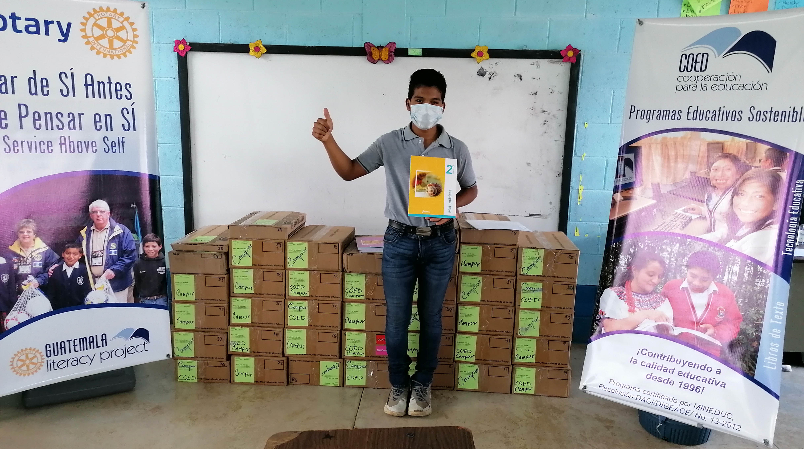
Notes:
As we have learned how to best support students throughout the pandemic, our team has done an amazing job strategizing how to adapt programs for schools in need. And we are continuing to have a lasting impact across rural Guatemala.
(If group presenting to already supports CoEd/GLP, thank them again for their support.)

Slide 24
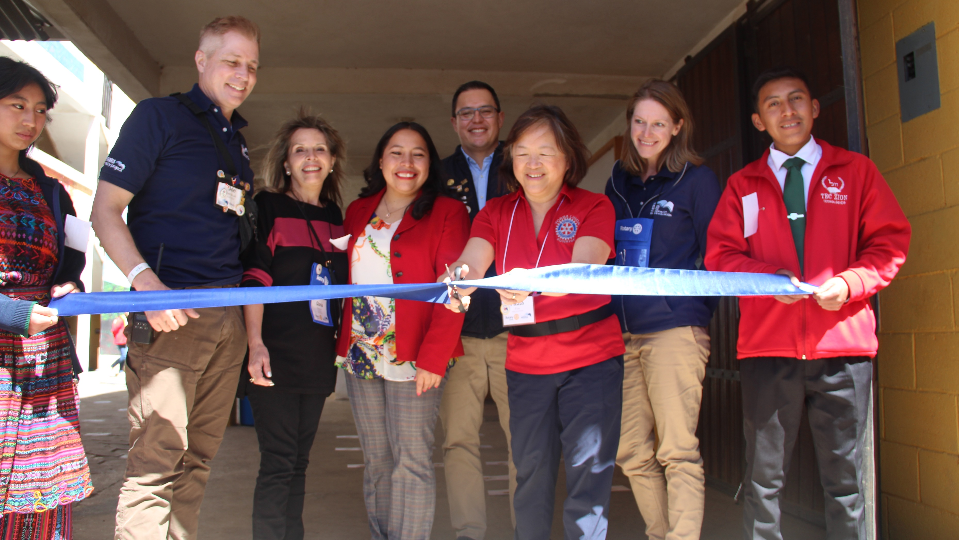
How To Get Involved
Notes:
How to get involved:

Slide 25
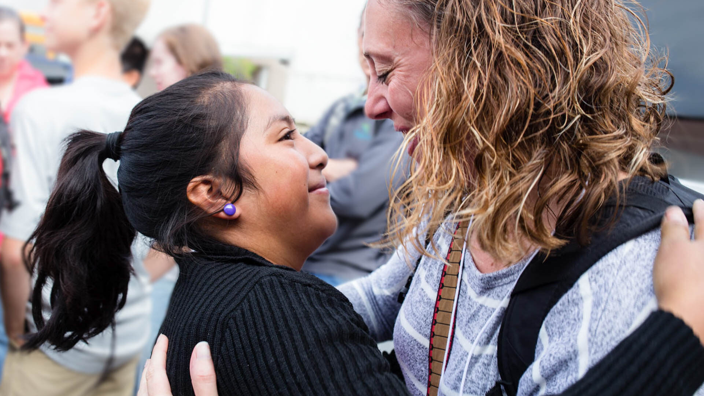
Become a Sponsor
Notes:
Just like President Jennifer Jones has done for several years… you too could directly sponsor one of our amazing Rise scholars.
Sponsor a student in the Rise program
($80/month or $960/year for a full scholarship)
Or you can support our sustainable technology program:
Sponsor a computer workstation
($1200 one-time gift)
Other sponsorships also available at guatemalaliteracy.org

Slide 26
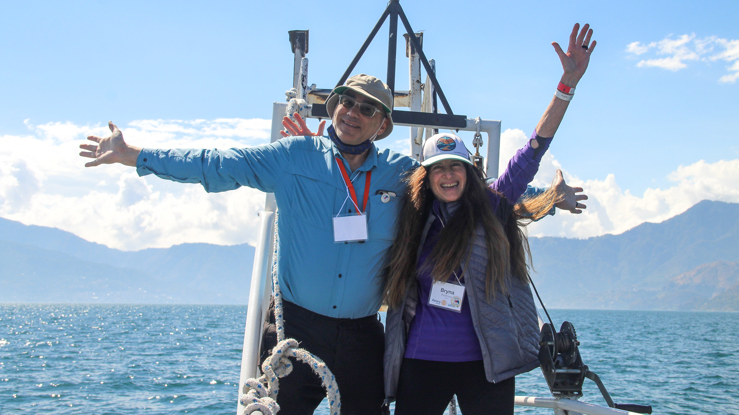
Travel to Guatemala
Notes:
Join us on tour to Guatemala to see the work in person!
Your life will never be the same… we guarantee it.

Slide 27
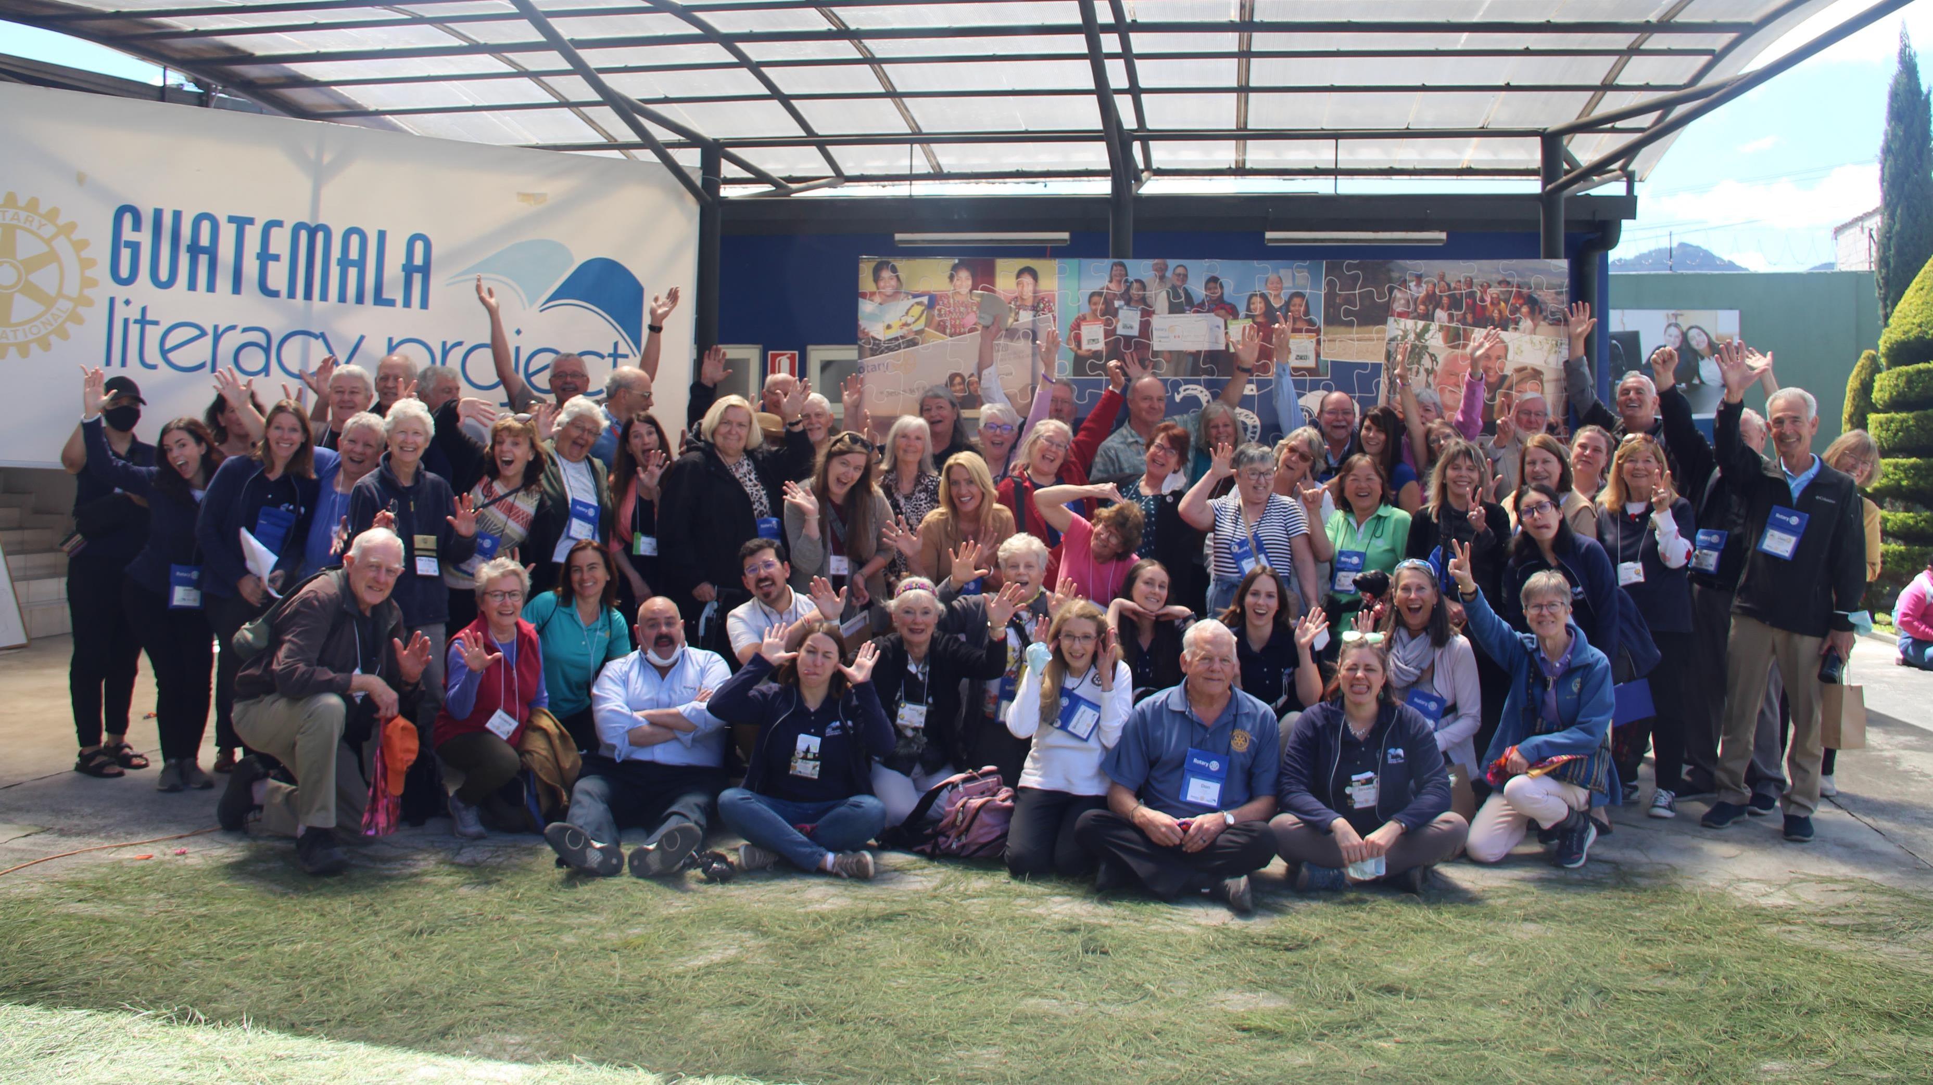
Notes:
Include fun group photo from a tour you were on, or known participants from group presenting to.
Talk about the community aspect of CoEd/GLP tours.

Slide 28
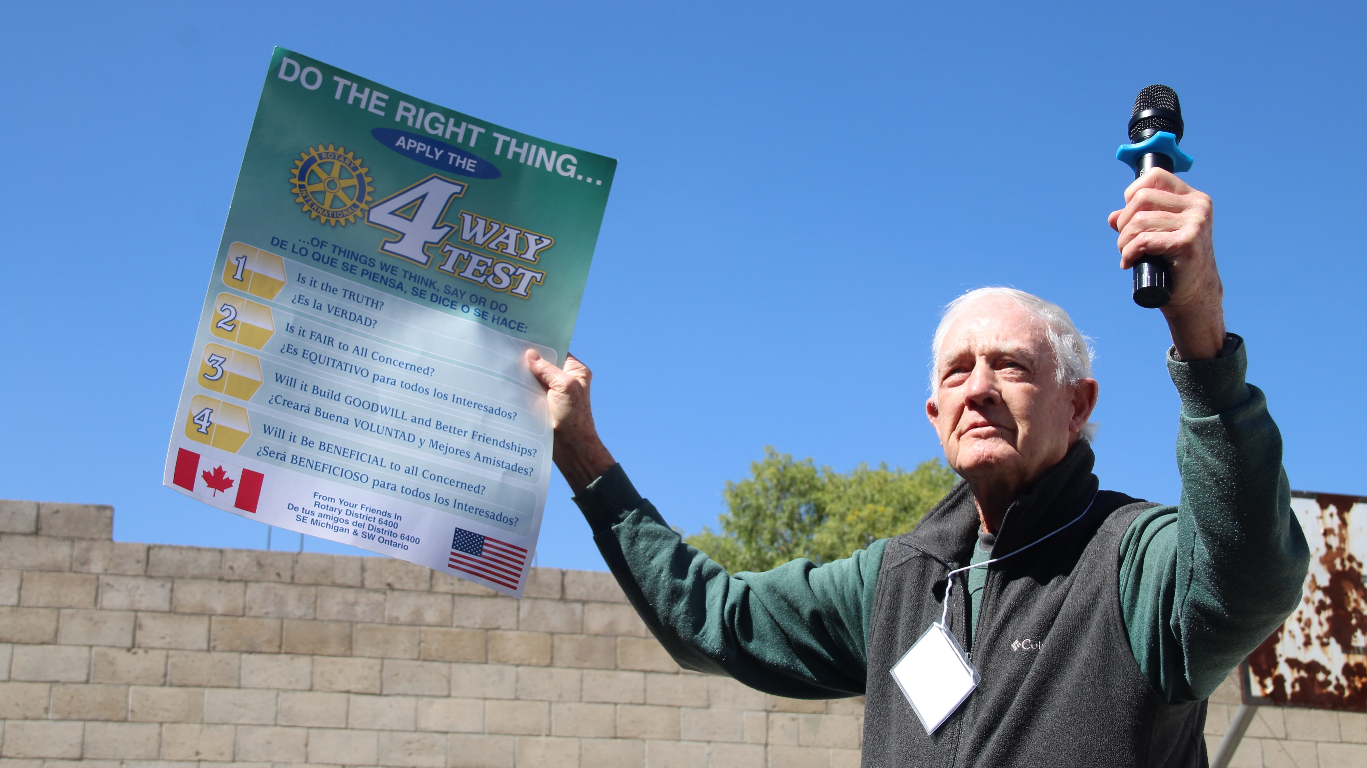
Join the Global Grant

Slide 29
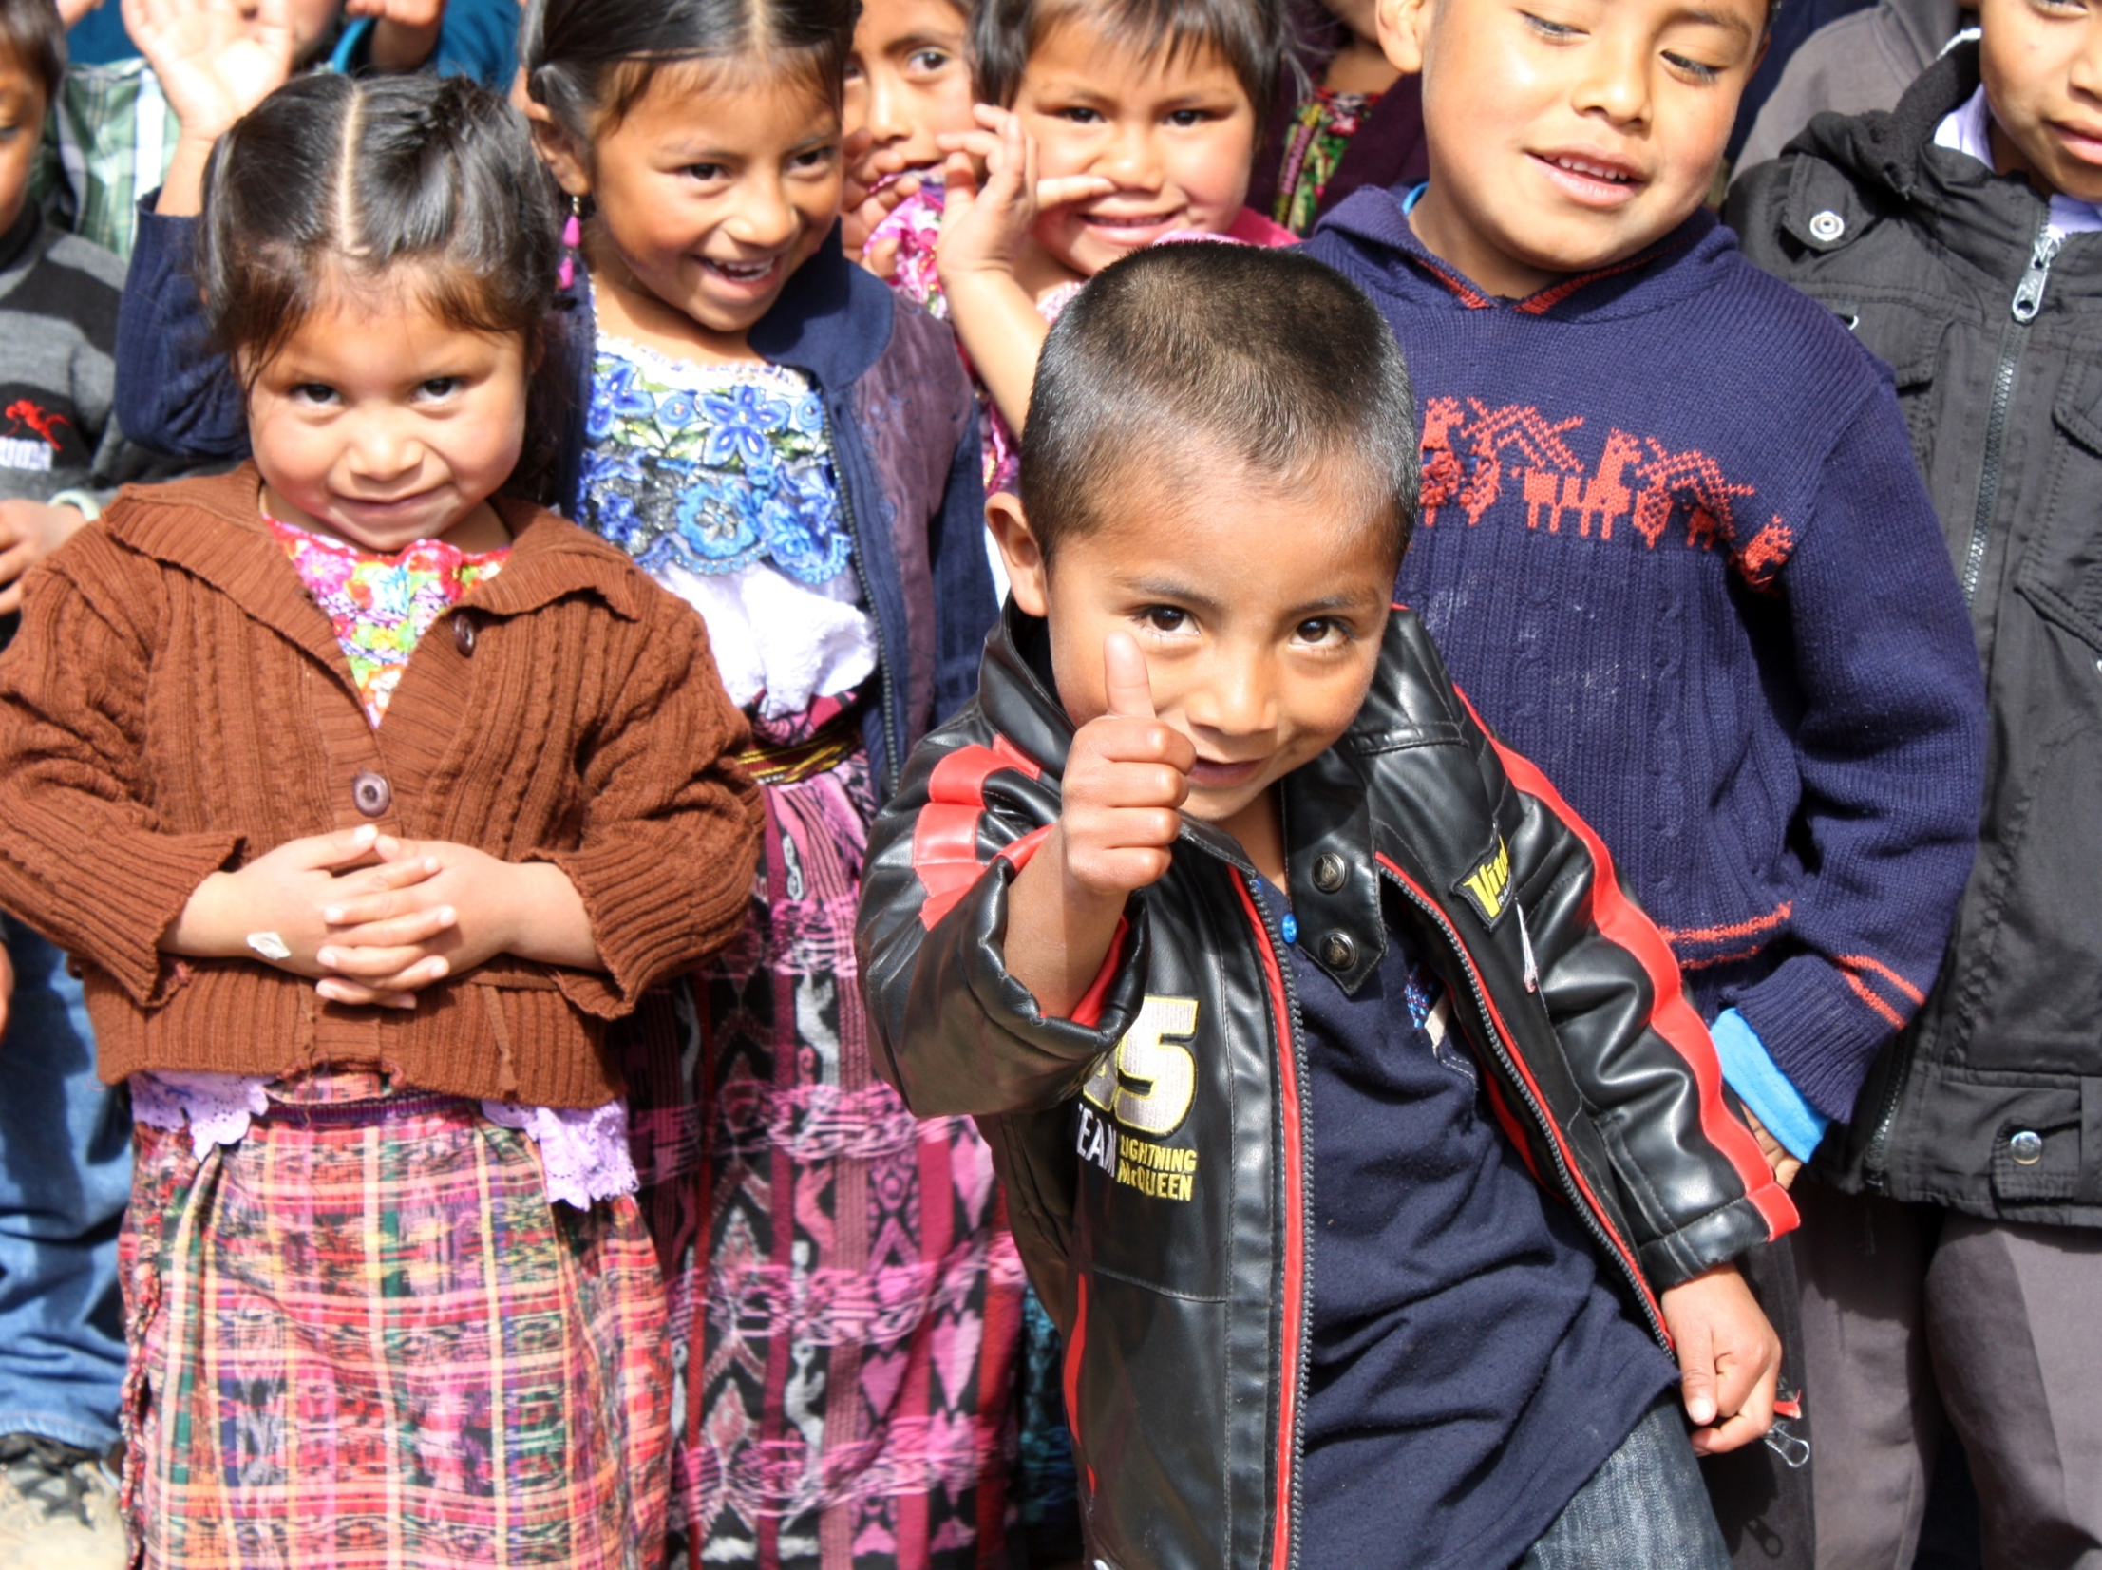
Thank you!
Notes:
Thank you so much for the opportunity to share our work at the Guatemala Literacy Project.
With support from more Rotarians like you, we know that the GLP will continue to help Guatemalan students gain important educational and life skills to help them break out of the cycle of poverty for their families… hopefully forever.

Slide 30
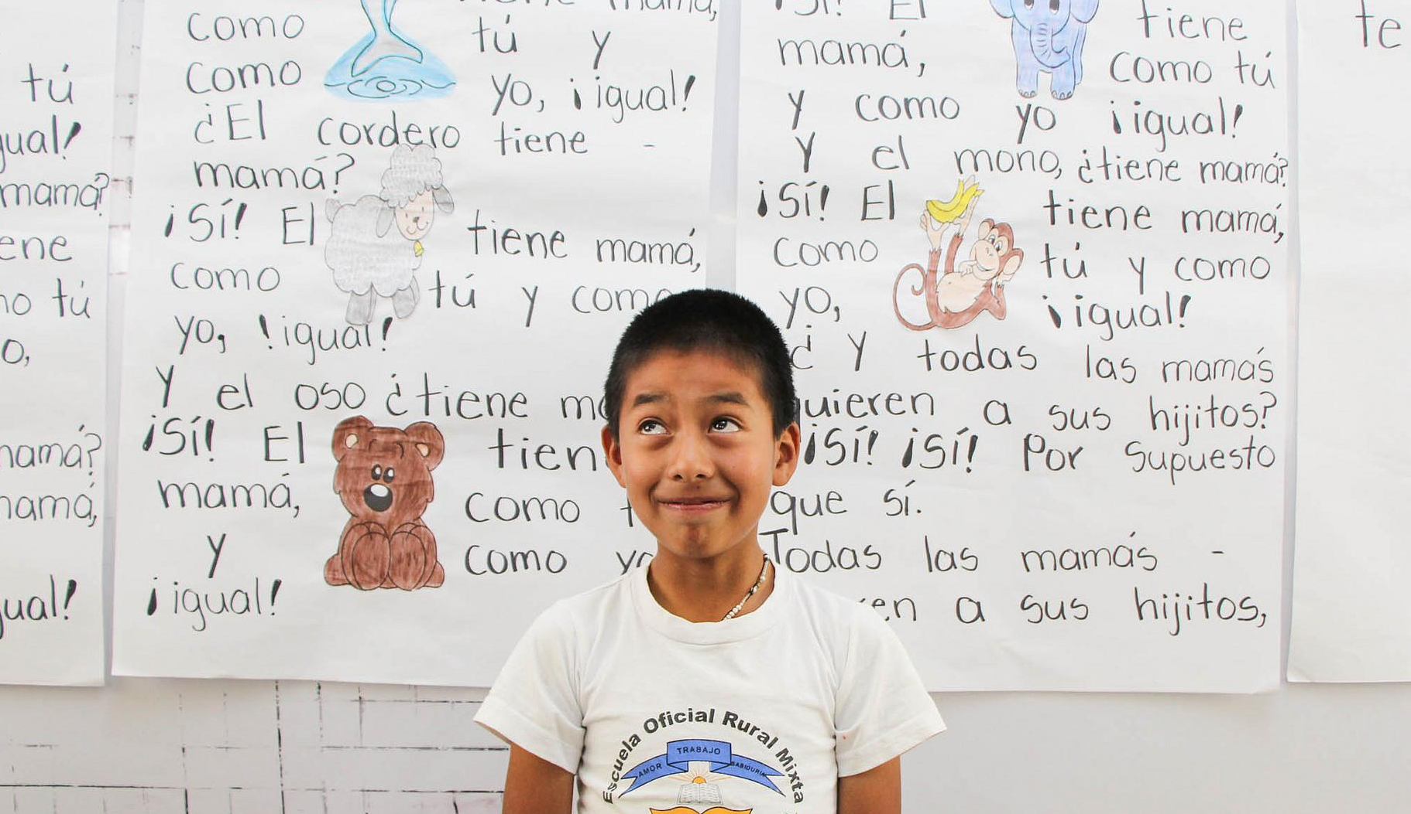
GuatemalaLiteracy.org
Notes:
You can learn even more about our project here on our website, guatemalaliteracy.org.
I would now like to open-up the floor for questions.
Note: In Zoom, stop sharing screen and return to gallery view.

